Slide 1



Development of a didactic robot
BSc in Informatics and Multimedia Engineering
Desenvolvimento de robô didático
Alexandre Figueiredo A48577
Daniela Gonçalves A48579
Advisors:
Prof. Carlos Gonçalves
Prof. Pedro Matutino
PRJ#27

Slide 2
Agenda
Topics covered:
Motivation
Related work
Use cases
Implementation
Future work
1

Slide 3
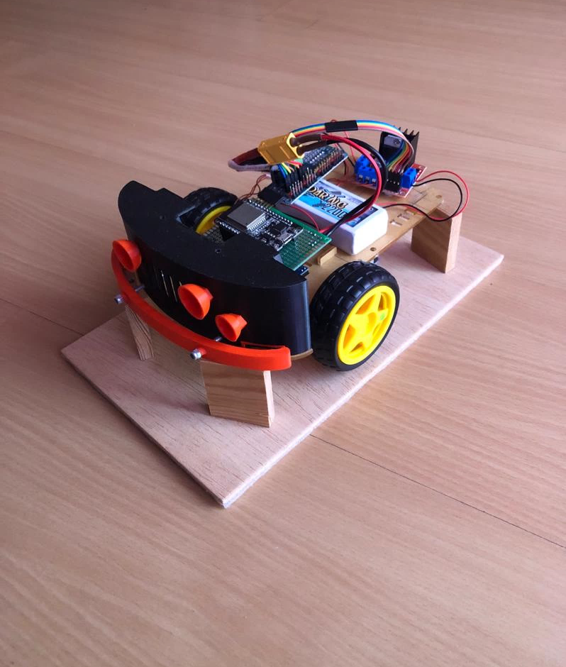
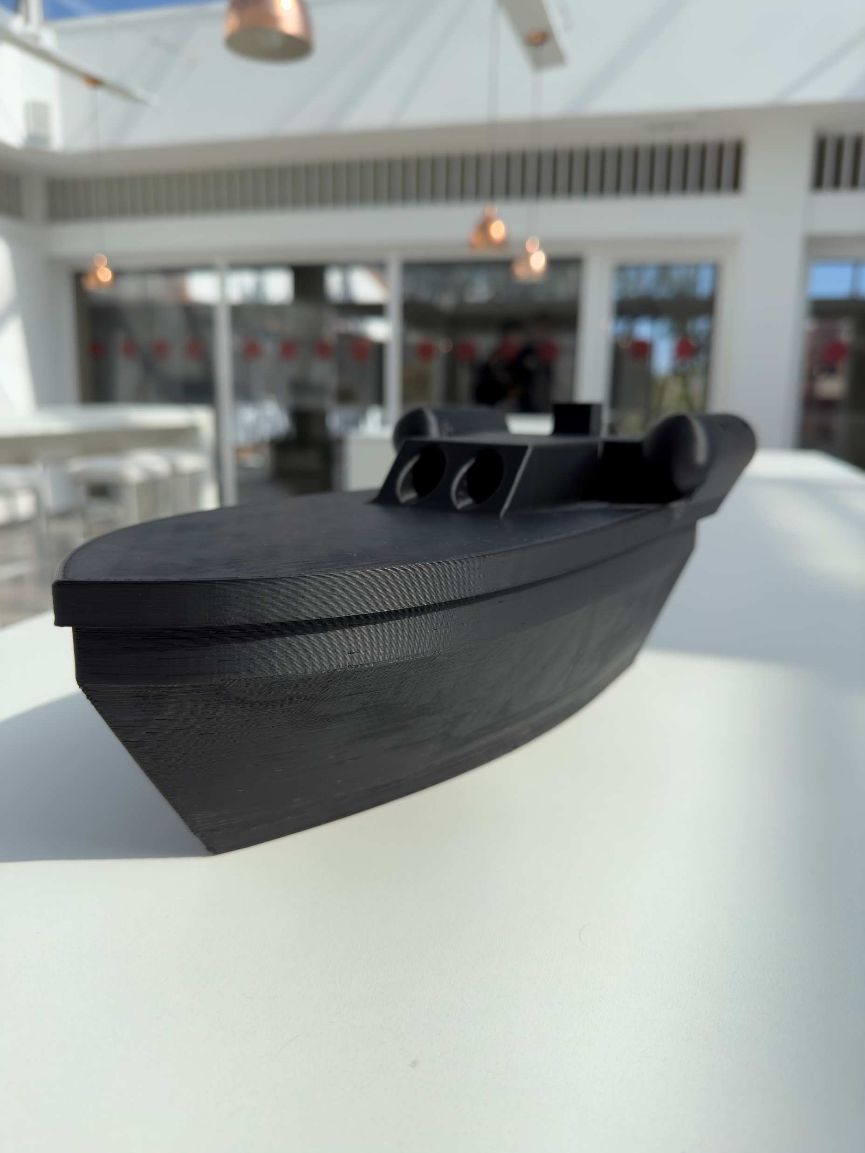
Motivation
The project aims at the development of a didactic robot capable of performing movements in 2D space. The ultimate goal is to create a prototype that had a set of interconnected sensors and actuators.
The robot must be able to establish communication with a device through Bluetooth connections.
2

Slide 4
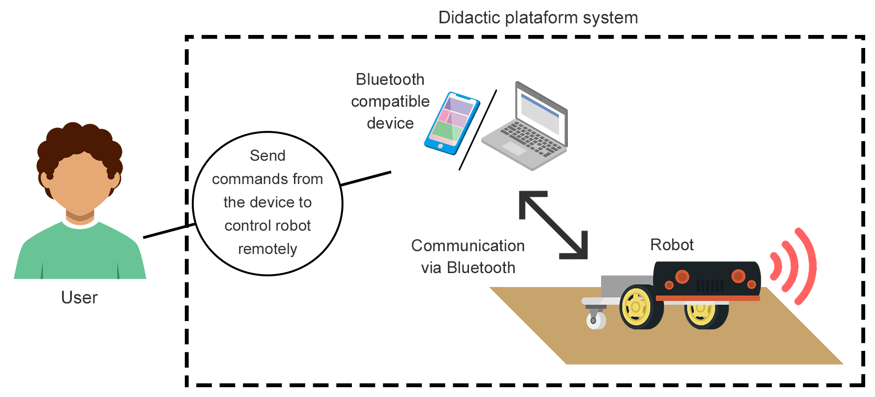

Motivation
3

Slide 5
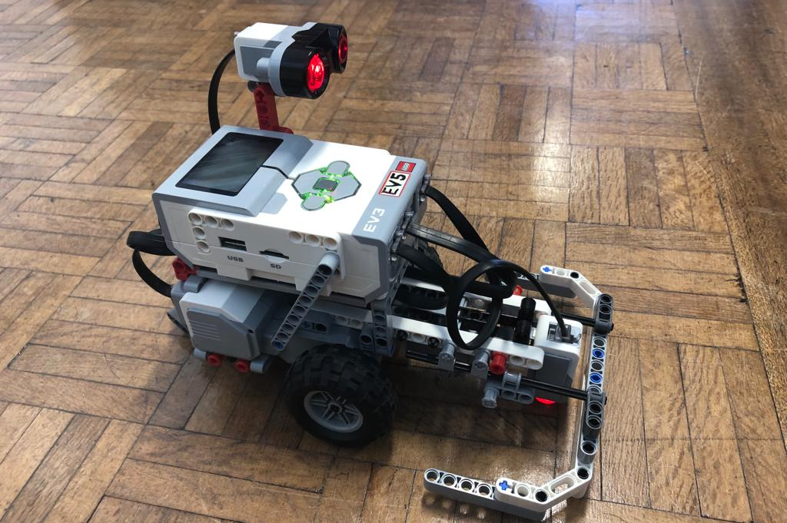
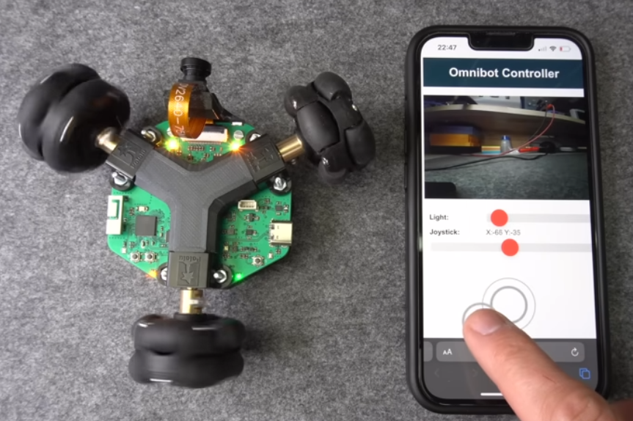
Related work
Base of “Fundamentos de Sistemas Operativos”, where a didactic platform was used as a way of learning. In order to learn how operating systems work, including concepts such as multithreading. A library was used to control the robot.
FSO Lego Mindstorms Robot
Omnidirectional three-wheel PCB robot based on an ESP32. It has an onboard camera whose stream can be viewed via a web server.
ESP32 based omnidirectional robot
4

Slide 6
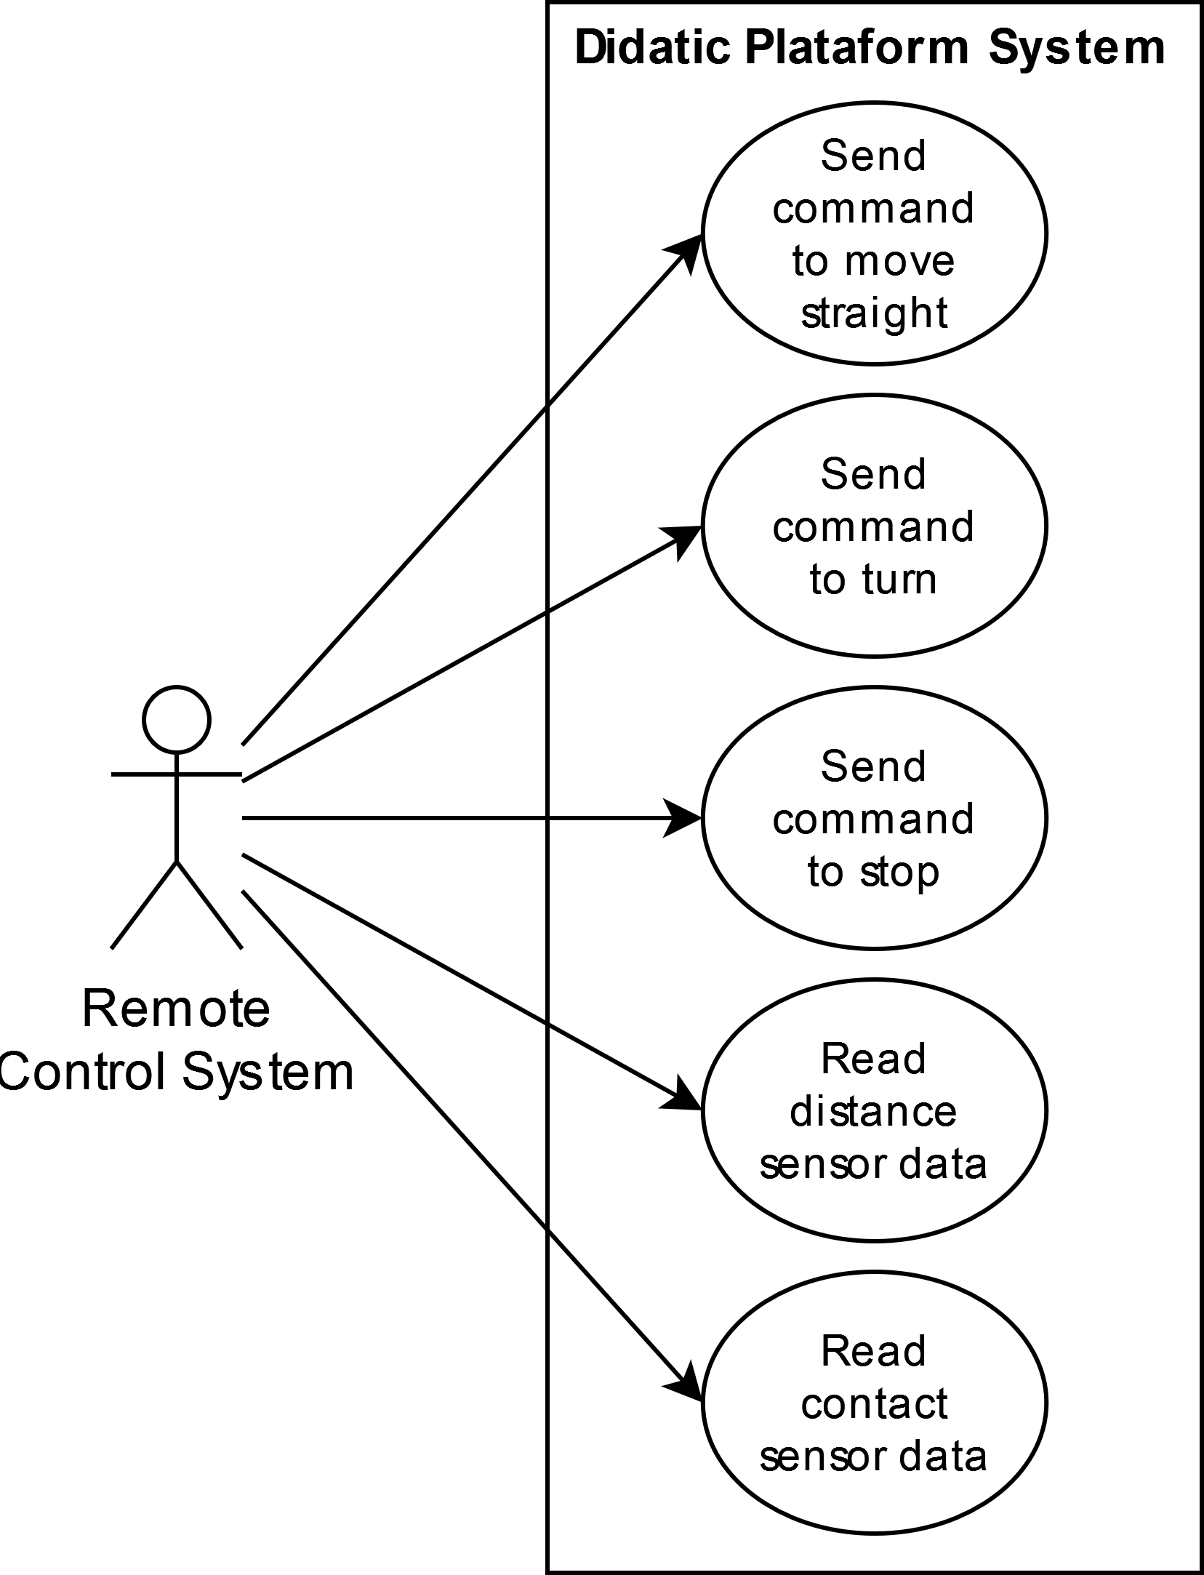
Use cases
5

Slide 7
Structure
Robot Library
Remote Control
Movement
Software
Motor
Sensor Reading
Expander
Microcontroller
Expansor
Hardware
…
Distance Sensor
Touch Sensor
Driver Module
Motor Encoder
Others
Motor
6

Slide 8
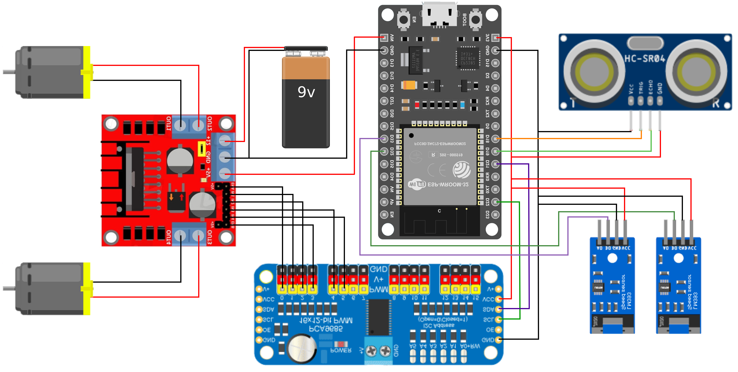
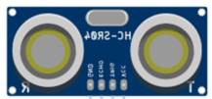
Assembly
Microcontroller ESP32
Distance Sensor SONAR
Motor
L298N Motor Driver
Motor
Encoders
Expander PCA9685
7

Slide 9



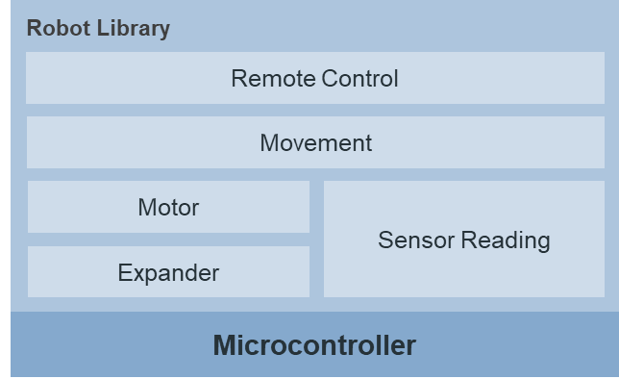
Software
8

Slide 10

Programming
𝑟
Move forwards and backwards
up to length 𝑥
Curves to the angle α, radius 𝑟 and speed 𝑣
9

Slide 11
Future work
For future work, it is intended to deepen other topics:
Creation of the application with the control commands via Bluetooth for Android or PC.
Artificial intelligence, allowing to analyze the environment around, adding a camera to the current prototype.
10

Slide 12

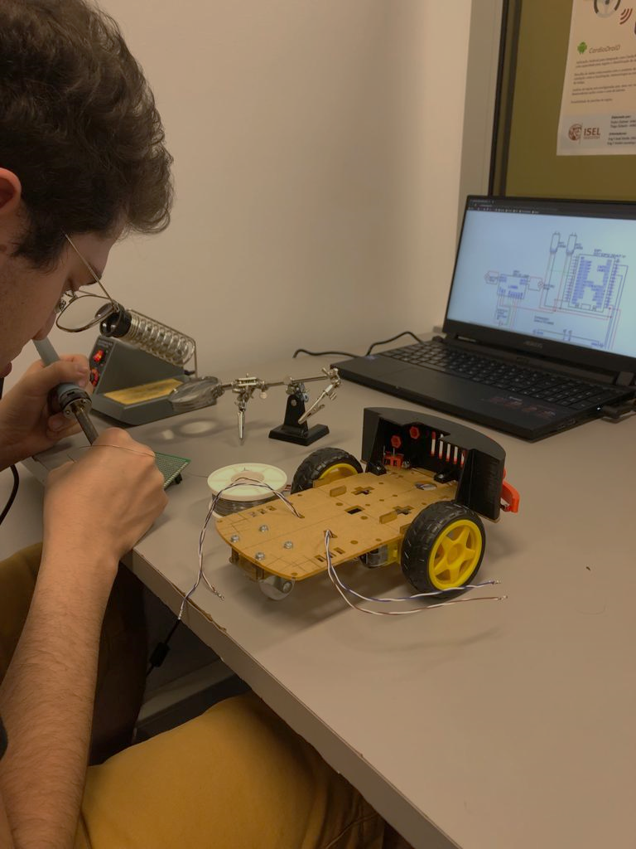
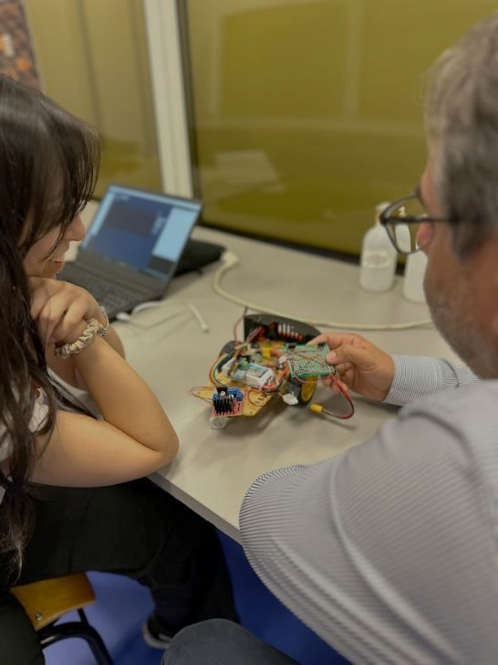

Questions?

